Slide 1
AI Based Card less ATM Transaction using Face Recognition
TEAM MEMBERS:
SUDHAKAR S
SATHISH KUMAR P
RAJAMANICKAM R
PROJECT GUIDE: Mrs.J.PRISKILLA ANGEL RANI

Slide 2
Scope of the Area
Image Processing
Artificial Intelligence

Slide 3
Problem Definition
Face recognition technology is a technique that is used to identify an individual’s face in an image or video. The main challenge in face recognition is to accurately identify a person’s face even in difficult conditions, such as low lighting or blurred images.
The primary problem in face recognition is that it requires accurate detection and alignment of the facial features, such as the eyes, nose, mouth, and jawline, in order to extract the relevant facial information for identification.
Moreover, privacy concerns and ethical issues associated with the use of face recognition technology have also emerged as a challenge in recent years. As a result, there is a need for advanced algorithms and techniques to improve the accuracy and robustness of face recognition systems, while ensuring privacy and ethical considerations are met

Slide 4
Objective
To design and implement a face recognition based ATM Transaction System using Convolutional Neural Network.

Slide 5
Abstract
The current ATM (Automated Teller Machine) system uses ATM card and PIN (Pin Identification Number) for authentication.
This system is likely to be harmed by many security issues such as theft of ATM card, skimming, Lebanese loop etc.
So in this project, we propose a system that uses face recognition authentication (not ATM cards) for accessing user account along with PIN which is more secure and reliable than the existing system. Here we are using the CNN model(Deep Learning Model) for face recognition.

Slide 6
Literature Survey
S.No | Journal Information | Inference
1 | Syed Safwan Khalid, Muhammad Awais, Zhen-Hua Feng, Member, IEEE Chi-Ho Chan, Ammarah Farooq, Ali Akbari and Josef Kittler Life Member, IEEE” Resolution Invariant Face Recognition using a Distillation Approach ” IEEE 2020 | In this project they propose to train a network using both HR and LR images under the guidance of a fixed network, pre-trained on HR face images. The guidance is provided by minimising the KL-divergence between the output Soft max probabilities of the pre-trained (i.e., Teacher) and trainable (i.e., Student) network as well as by sharing the Soft max weights between the two networks.

Slide 7
Literature Survey
S.No | Journal Information | Inference
2 | Khushboo Yadav, Suhani Mattas, Lipika Saini, Poonam Jindal” Secure Card-less ATM Transactions ” IEEE 2020 | we propose a Secure Card less Transaction System- a method which would eliminate the usage of ATM PIN and physical cards altogether and hence provide a secure environment for cash withdrawal. The concept of User Generated One Time Password (OTP) has been introduced in this project. With all these modification in-existing systems, the robustness of the machines will increase.

Slide 8
Literature Survey
S.No | Journal Information | Inference
3 | Xiaoming Liu Michigan State University” FAN: Feature Adaptation Network for Surveillance Face Recognition and Normalization ” IEEE 2019 | This paper studies face recognition (FR) and normalization in surveillance imagery. Surveillance FR is a challenging problem that has great values in law enforcement. Despite recent progress in conventional FR, less effort has been devoted to surveillance FR. To bridge this gap, we propose a Feature Adaptation Network (FAN) to jointly perform surveillance FR and normalization

Slide 9
Literature Survey
S.No | Journal Information | Inference
4 | Indranil Banerjee, Sjivangam Mookherjee, Sayantan Saha, Souradeep Ganguli, Subham Kundu, Debduhita Chakravarti” Advanced ATM System Using Iris Scanner ”IEEE 2019 | The presented design is unique because of biometric scanners such as Iris scanner and the two-way check with fingerprint scanner makes it more reliable. The iris scanner being the primary security check lets the system access the further steps for transaction. Fingerprint scanner embedded in the ATM card acts as the secondary security check for the system. The transaction procedure is successful only if the input data by the card holder matches with the database. It consumes less energy that makes it suitable for use. The suggested modified system is pragmatic moreover economical when correlating to the alternative existing classification and affirmation processes of ATMs.

Slide 10
Literature Survey
S.No | Journal Information | Inference
5 | Divyans Mahansaria, Uttam Kumar Roy” Secure Authentication for ATM transactions using NFC technology ” IEEE 2019 | In the proposed system, in order to authenticate at the ATM kiosk, the user needs to swipe his/her smart phone in front of the NFC reader. An ATM card is not required for authentication and the system will still have a stronger security compared to the system in which ATM card was used. Security analysis and threat modelling shown in this paper highlights the security strength of the system during authentication.

Slide 11
Literature Survey
S.No | Journal Information | Inference
6 | Sweta Singh, Akhilesh Singh, Rakesh Kumar” A Constraint-based Biometric Scheme on ATM and Swiping Machine ” IEEE 2016 | This paper envelops two questions “Is it really worthy to go through the entire biometric process to just debit a low amount?” and “What could be the maximum amount one can lose if one’s card is misused?” As an answer we propose a constraint on transactions by ATM involving biometric to improve the system performance and to solve the defined issues The proposal is divided in two parts. The first part solves sensor performance issue by adding a limit on amount of cash and number of transactions is defined in such a way that if one need to withdraw a big amount OR attempts for multiple transactions by withdrawing small amount again and again, it shall be necessary to present biometric.

Slide 12
Literature Survey
S.No | Journal Information | Inference
7 | Zubair Shah, Abdun Naser Mahmood, Member, IEEE, Zahir Tari, Member, IEEE, Albert Y. Zomaya Fellow, IEEE “A Technique for Efficient Query Estimation over Distributed Data Streams” IEEE 2016 | In this paper, we propose an efficient query estimation technique by constructing a small sketch of the data stream. The constructed sketch uses a deterministic sliding window model and can estimate various complex queries, for both centralized and distributed applications; including point queries (i.e., range queries and heavy hitter queries), quantiles, inner product, and self-join size queries, with deterministic guarantees on the precision. The proposed approach improves upon recent existing work for these problems, in terms of the memory and query cost in a centralized setting and in terms of communication cost and merge complexity in a distributed setting.

Slide 13
Literature Survey
S.No | Journal Information | Inference
8 | Indrajani, 1Yaya Heryadi, 2Lili Ayu Wulandhari, Bahtiar Saleh Abbas” Recognizing Debit Card Fraud Transaction Using CHAID and K-Nearest Neighbor: Indonesian Bank Case ” IEEE 2016 | This paper presents a preliminary study on debit card fraud transaction recognition, whose cards are issued by Indonesian bank, based on actual ATM transaction records. The premise of this research is fraudulent transaction contains ‘anomaly’ from the pattern of non-fraudulent transactions so that the anomalous pattern can be detected and separated at some point using classification models. Less availability dataset for research, non-stationary distribution of the data, highly imbalanced class distributions, and continuous streams of transactions become the main driven of using CHAID and k-NN classification method.

Slide 14
Literature Survey
S.No | Journal Information | Inference
9 | Anusha Mandalapu, Daffney Deepa V, Laxman Deepak Raj, Anish Dev J” An NFC featured three level authentication system for tenable transaction and abridgment of ATM card blocking intricacies ” IEEE 2015 | The auxiliary feature of blocking ATM cards is implemented using a QR code authentication scheme and NFC technology, implemented both in NFC enabled phones and non-NFC phones (with the help of an NFC transmitter, receiver and Bluetooth). The proposed system, therefore, ensures both secure usage of ATM cards and cost effectiveness by utility of novel and increasingly common technology, when also simultaneously proving to be user friendly.

Slide 15
Literature Survey
S.No | Journal Information | Inference
10 | Rajeev Ranjan, Ankan Bansal, Jingxiao Zheng, Hongyu Xu, Joshua Gleason, Boyu Lu, Anirudh Nanduri, Jun-Cheng Chen, Carlos D. Castillo, Rama Chellappa “A Fast and Accurate System for Face Detection, Identification, and Verification” IEEE 2015 | In this paper, they describe the details of a deep learning pipeline for unconstrained face identification and verification which achieves state-of-the-art performance on several benchmark datasets. We propose a novel face detector, Deep Pyramid Single Shot Face Detector (DPSSD), which is fast and capable of detecting faces with large scale variations (especially tiny faces).

Slide 16
Modules
Data collection
Pre-processing
Training
Testing

Slide 17
Module Description
In our project at first we are going to collect the user’s face images we will capture each users face for 50 times and all the 50 images are stored in the separate folder.
The collected face images of users are used for Training purpose and validation purpose.
After data collection the user’s face images are pre-processed by using pre-processing techniques such as zooming, shearing, rescaling and horizontal flipping.
These pre-processed data’s are then feeded into our Convolutional Neural Network model.
Training Process is conducted by using Convolutional Neural Network and the trained model is saved as a file for testing purpose

Slide 18
Module Description
In our project we will train the image data for more than 100 times to reach the 97% accuracy.
After training we can able to classify the users faces in real time by using the trained model.
Testing a image using our trained model will also give 97% accurate result.
Once the users image is predicted, then their banking details are received and then the machine asks for the 4 digit secret pin from the user to continue the transaction.
If their face and 4 digit pin number is matched, then they can able to make transaction, if it is not matched then they can’t able to make transactions in the ATM.

Slide 19
Existing System
In the existing system they used pretrained weight for detecting high range and low range face images, their accuracy also not a stable one.
Pros
Good at low resolution
Cons
Their accuracy is not stable

Slide 20
Proposed system
In the Proposed system we used a deep learning technique which is called as Convolutional Neural Network to recognize the face. Here we are using Deep Neural Network Architecture. And hence we can able to get a high and stable accuracy. We able to get accuracy of above 90%.
Pros
Good accuracy

Slide 21
Tools Used
Hardware Tools
A PC which runs with windows operating system
Software Tools
Python IDE
Software package
matplotlib
Numpy
Sklearn
tensorflow
opencv

Slide 22
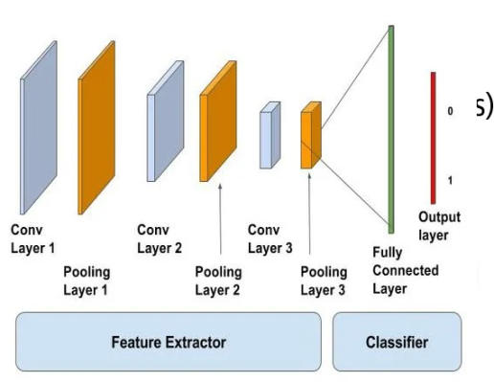
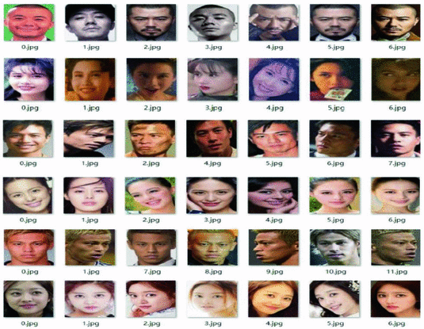
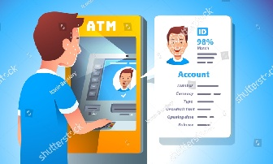
Proposed System Architecture
Pre processing
Input Face Dataset
Training Using Convolutional Neural Network
Trained Model
Testing using the trained model
And move forward for ATM Transaction

Slide 23
TRAINING
Convolutional
Neural Network
Pre-processing
Convolutional Layer
Rescaling
Shearing
Max Pooling Layer
Input Training Images
Trained Model
Zooming
Flattening Layer
Horizontal Flipping
Fully connected Layer with Multiple Hidden Layer

Slide 24
TESTING
Input Face Image
User ID and Bank Details
Trained Model
Make ATM Transaction
Comparing face and pin
Getting 4 digit pin

Slide 25
Conclusion
In our project, we created a model which can authenticate user by using their we used deep learning technique and hence we will get an accuracy of over 95% and its output is stable.
In future work we will add some extra hardware modules to view it as real. And we will increase the accuracy of the model by using hybrid deep learning models.

Slide 26
References
Syed Safwan Khalid, Muhammad Awais, Zhen-Hua Feng, Member, IEEE Chi-Ho Chan Ammarah Farooq, Ali Akbari and Josef Kittler Life Member, IEEE. “Resolution Invariant Face Recognition using a Distillation Approach”,2020.
Xiaoming Liu Michigan State University. “FAN: Feature Adaptation Network for Surveillance Face Recognition and Normalization”,2019.
Rajeev Ranjan, Ankan Bansal, Jingxiao Zheng, Hongyu Xu, Joshua Gleason, Boyu Lu, Anirudh Nanduri, Jun-Cheng Chen, Carlos D. Castillo, Rama Chellappa . “A Fast and Accurate System for Face Detection, Identification, and Verification”,2015.
Sweta Singh, Akhilesh Singh, Rakesh Kumar “ A Constraint-based Biometric Scheme on ATM and Swiping Machine”,2016 IEEE.
Zubair Shah, Abdun Naser Mahmood, Member, IEEE , Zahir Tari, Member, IEEE, Albert Y. Zomaya Fellow, IEEE.“A Technique for Efficient Query Estimation over Distributed Data Streams”,2016 IEEE.

Slide 27
Indranil Banerjee, Sjivangam Mookherjee, Sayantan Saha, Souradeep Ganguli, Subham Kundu, Debduhita Chakravarti.“Advanced ATM System Using Iris Scanner”,2019 IEEE.
Divyans Mahansaria, Uttam Kumar Roy.“Secure Authentication for ATM transactions using NFC technology”,2019 IEEE.
Anusha Mandalapu, Daffney Deepa V, Laxman Deepak Raj, Anish Dev J.“An NFC featured three level authentication system for tenable transaction and abridgment of ATM card blocking intricacies”,2015 IEEE.
Indrajani, 1Yaya Heryadi, 2Lili Ayu Wulandhari, Bahtiar Saleh Abbas.“Recognizing Debit Card Fraud Transaction Using CHAID and K-Nearest Neighbor:Indonesian Bank Case”,2016 IEEE.
Khushboo Yadav, Suhani Mattas, Lipika Saini, Poonam Jindal.“Secure Card-less ATM Transactions”,2020 IEEE.

